Slide 1
Investment Theory
Making Investment Decisions

Slide 2
Agenda
Price vs. Value
Margin of Safety
Value Investing
Reflexivity
Expected Return
Dealing with Risk
Investment Checklist

Slide 3
Price vs. Value

Slide 4
Price and Value
You can employ value investing when price and value are unequal
Price – a result of supply and demand in the market
Value - present value of future cash flows (remember valuation and DCF)
A company’s stock price can change even when the company’s value or valuation has remained the same
“Price is what you pay, but value is what you get” – Warren Buffet

Slide 5
Why can price ≠ value?
Stock prices reflect investors’ perception of reality and not necessarily reality itself
Overvalued (Price > Value)
Undervalued (Price < Value)
Overhyped, plays into a trend
Unreasonable growth expectations
Market overreacts to good news
Large analyst coverage (typically large companies)
In an overlooked industry
Market has a short-term rather than a long-term outlook at the business value
Market overreacts to bad news
Little analyst coverage (typically small companies

Slide 6
Margin of Safety

Slide 7

Margin of Safety
Margin of Safety measures the degree of downside protection
So much attention is paid to the upside that it is easy to lose sight of the risk
Greater risk does not guarantee greater return; risk can reduce return by causing losses
A margin of safety is necessary because valuation is an imprecise art, the future is unpredictable, and investors can make mistakes
This is why we predict bear, base, and bull cases

Slide 8
Margin of Safety
Value investors require some room for error in their estimation of value, and they often set their own margin of safety based on their particular risk tolerance
Margin of safety is based on the premise that buying stocks at bargain prices gives you a better chance at earning a profit later when you sell them
Margin of safety also makes you less likely to lose money if the stock doesn’t perform as you had expected

Slide 9
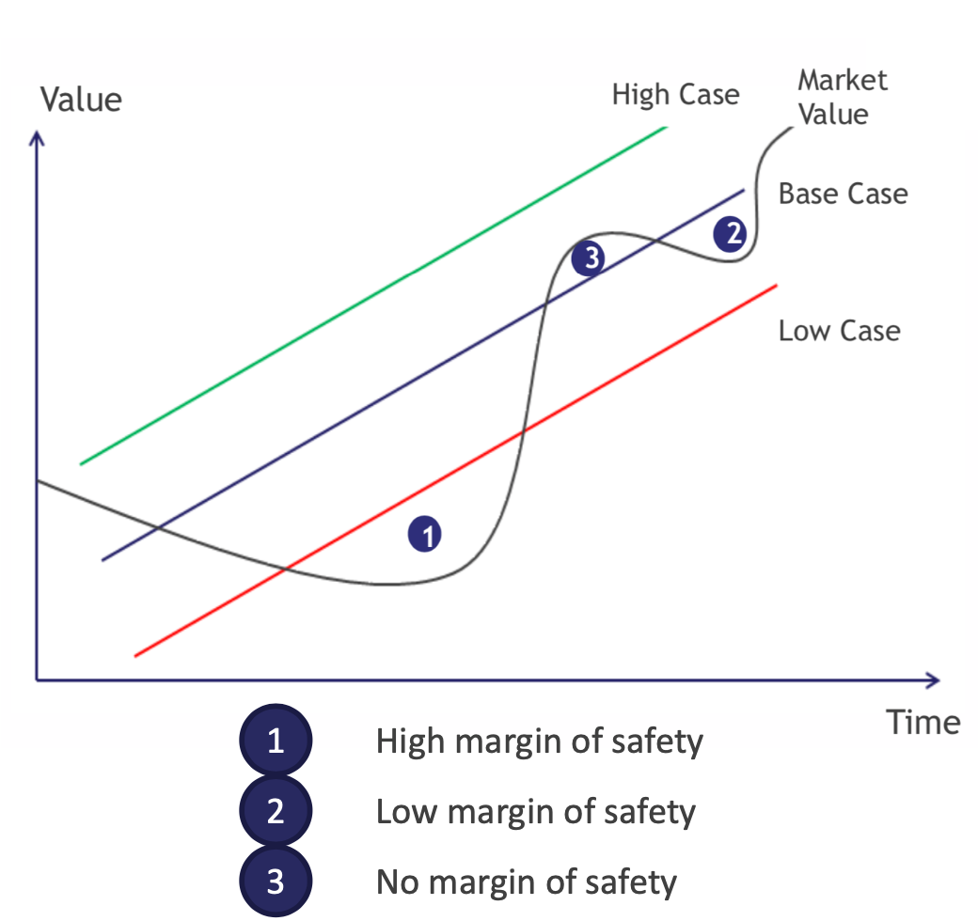
Margin of Safety, pictured

Slide 10
What is Value Investing?

Slide 11
What is Value Investing?
The idea behind value investing is to buy stocks that are believed to be currently undervalued
Undervalued opportunities are stocks that are currently trading below their intrinsic value
Ask yourself: What is the market missing with this company? Why is this company worth more than the market suggests?
Invest when the stock is selling low, with the expectation that the price will converge to its true intrinsic value, which will yield returns (a.k.a. “buy low, sell high”)
Risk-adjusted returns

Slide 12
Value Investing Rationale
Value investors believe that the market is mispricing the stock in some way (overreaction to good/bad news, trends, etc), resulting in stock price movements that do not reflect a company's long-term fundamentals and growth prospects
The overreaction offers an opportunity to profit by buying stocks at discounted prices – on sale
Value investors use financial analysis, don't follow the herd, and are long-term investors of quality companies

Slide 13
Famous Value Investors
Warren Buffet: billionaire and CEO of Berkshire Hathaway
Benjamin Graham: Buffett’s professor and mentor
Seth Klarman: billionaire hedge-fund manager (Baupost Group)
Charlie Munger: Vice Chairman of Berkshire Hathaway

Slide 14
Reflexivity

Slide 15
What is reflexivity?
Reflexivity is the idea that a company’s price can affect its fundamentals
This is contrary to the idea of ”traditional value,” where fundamentals only affect price but not vice versa
Warren Buffet is a believer of traditional value as opposed to reflexivity
According to reflexivity, fundamental affect price, but price also affects fundamentals

Slide 16
How can price affect fundamentals?
Rising stock prices can lead to higher demand for the stock
In the financial markets, rising prices often attract buyers
As a result, sometimes higher demand leads to higher prices which leads to even more demand
This prevents an equilibrium from forming and eventually creates a bubble

Slide 17
Expected Return

Slide 18
Risk and Return
All investment decisions hinge on the balance between risk and returns
Return Drivers
Risk Factors
Yield
Earnings Growth
Change in Valuation
Business Uncertainty
Price
Time Horizon
Remember : Risk and return are the twin pillars of investing – each is just as important as the other

Slide 19
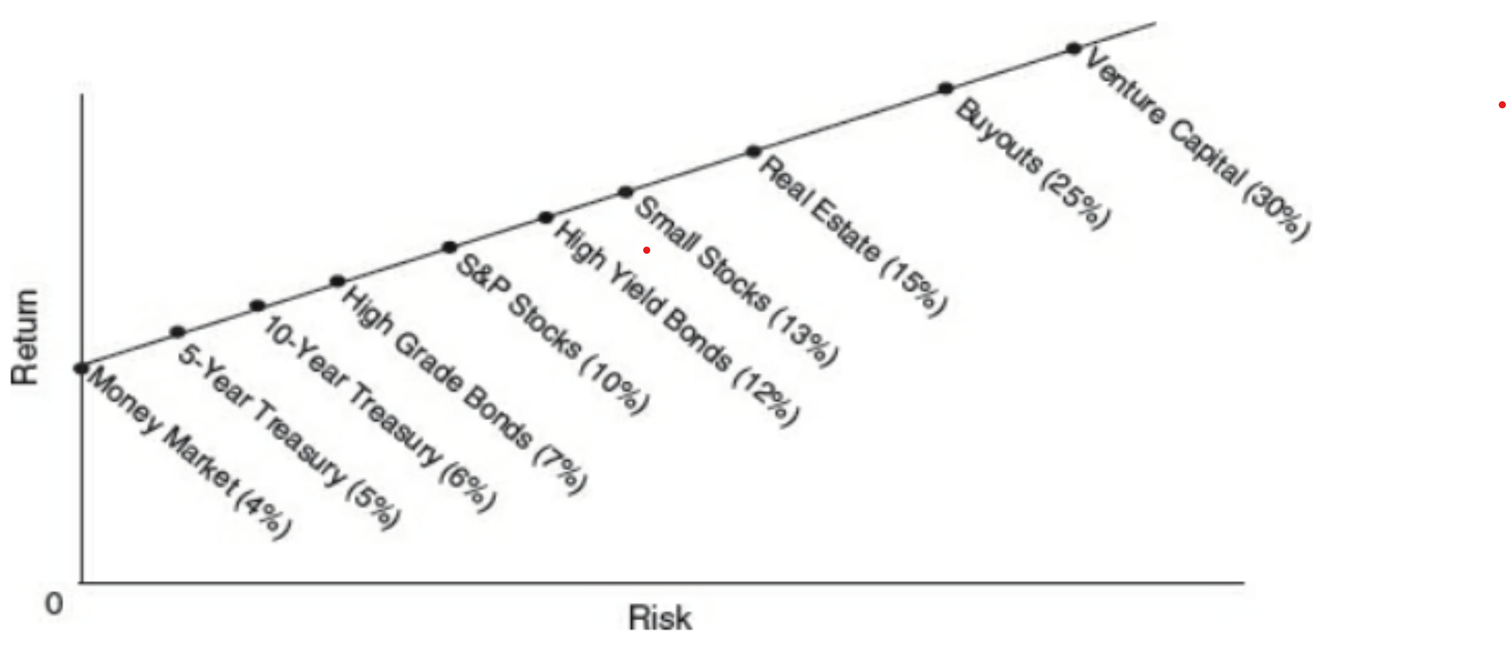
Risk and Return
Rational people are (generally) risk averse
Investors should demand higher rates of return in exchange for taking on more risk
Therefore, if markets are efficient, the only way to increase your expected return is to take on more risk

Slide 20
Expected Return
Total Return = Dividend Yield + ΔEPS + ΔP/E Ratio
Breaking this formula down :
1) Dividend Yield – Expected Yield on Investment
2) Change in EPS – Expected Growth
Change in Revenue
Change in margins
Change in number of shares outstanding
3) Change in PE Ratio – Change in Valuation
- Change in implied earnings growth
- Change in bond yields
- Change in risk premium (ERP due to the riskiness of company)

Slide 21
Back of the Envelope Valuation
When it comes to investing, keeping things simple often results in better results.
Conducting a Back of the Envelope Valuation :
1) Estimate earnings growth over the next 3-5 years (or whatever time period is convenient)
For Example : ROIC*Reinvestment Rate
Revenue Growth and Margin expansion/contraction
Will they gain market share or is the market growing?
Is there operating leverage?
What are unit-level margins?
Is the cost structure primarily fixed or variable?
Share buybacks (if using a multiple based on EPS)
2. Apply a terminal multiple
Remember even if you are growing really fast now it’s likely your terminal multiple will converge to the market multiple to reflect your less super-normal growth in the future

Slide 22
Back of the Envelope Valuation
3. Use your estimated market cap 5 years from now to calculate your annualized return
Have to also account for any capital returned to shareholders (e.g. dividends)
Annual return comes from growth in share price (converted into an CAGR) and annual dividend yield
4. Compare your expected return to the perceived risk of the investment and decide if it’s worth it

Slide 23
Simple Example Valuation
Approximate Return 2% Dividend Yield + 10% EPS growth + 25% annual multiple expansion = 37% approx. annualized return
Company A now
Company A Next Year
$100 in earnings
Trades at 20x Earnings, so market cap is $2000 dollars
Expects to grow earnings 10% this year
Will pay a 2% dividend yield
Multiple after next year will be 25x
$110 in earnings
Market Cap is now $2750 dollars
Stock Price is therefore 37.5% greater
Dividend Yield was 2%
Total Actual Return is 39.5%

Slide 24
Example for you to try
Daniel's Water Bottle Company (currently 19X forward PE)
1. Dividend
Does not pay a dividend
2. Earnings Growth
Approximate revenue growth at 6% annually (3% SSS and 3% from new stores)
Experiencing margin expansion so say that increases earnings growth to 8%
Reduce share count 15% over 5 years (in-line with historical buyback activity), which increases earnings growth to 11% per year
3. Multiple expansion/contraction
Above-average growth, recession-resilient business, shareholder friendly management team, so slight premium to the market seems reasonable
Market historically trades at 16x, so an 18x forward multiple seems appropriate

Slide 25
Answer: Approximate Return 0% Dividend Yield + 11% EPS growth - 1% annually from multiple contraction = 10% approx. annualized return

Slide 26
Dealing with Risk

Slide 27
Taking on Risk is Tricky
Taking on more risk doesn’t guarantee a higher return
Often too many people can be overheard saying, “Riskier investments provide higher returns. If you want to make more money, the answer is to take more risk.”
But riskier investments absolutely cannot be counted on to deliver higher returns. Why not? It’s simple: if riskier investments reliably produced higher returns, they wouldn’t be riskier!
The correct formulation is that in order to attract capital, riskier investments have to offer the prospect of higher returns, or higher promised returns, or higher expected returns

Slide 28
Uncertainty
Uncertainty can be defined as the range of possible outcomes which could occur.
Uncertainty is an endogenous property
This means that it depends on the properties of the security in which we’re investing and the macroeconomic environment
Can’t be controlled by investors
Three main types of uncertainty:
Macroeconomic – How uncertain am I about the macroeconomic future? How much potential is there for discount rates to rise?
Firm-Specific - How uncertain am I about the company’s future? How will the company fare in a macroeconomic environment which is poor for equities?
"Reflexive” - How will the company have to modify its behavior if things don’t go as expected? What would the consequences of these modifications be for the company?

Slide 29
Uncertainty
1) Macroeconomic Uncertainty / systematic
Uncertainty about the future macroeconomic environment
The direct effect of macroeconomic changes on the security
Primary risk is from rising interest rates or risk premiums
2) Firm-Specific Uncertainty / idiosyncratic
Uncertainty about the strength of the firm’s core business
Uncertainty about the industry in which the firm operates
Uncertainty surrounding the firm’s performance in a recession
3) Reflexive” Uncertainty
Second-order consequences (due to behavior modification) of firm-specific and macroeconomic uncertainty
What actions the firm can/will take in the future depends on the firm’s circumstances in the future (which are uncertain)

Slide 30
Risk
Risk is the chance of loss we assume when entering an investment
Risk is an exogenous property
There are three main sources of risk
Depends on not just endogenous properties of the security (uncertainty) but also the circumstances under which we purchase the security
Can be controlled (to a certain extent) by investors
Price
Time Horizon
Uncertainty

Slide 31
Sources of Risk - Price
The cheaper we purchase an asset for, the lower our chance of capital loss
There will always be a range of possible outcomes with any given investment
We can decrease risk by
Minimizing the percentage of those outcomes which will result in capital loss
Minimizing the size of the expected capital loss in the event that loss does occur
Both of these goals can be achieved by buying assets when prices are cheap

Slide 32
Sources of Risk – Time Horizon
The risk we assume in purchasing a security depends on the time horizon of our investment
Short Time Horizon
Long Time Horizon
If our time horizon is short, we care much more about short-term volatility and are generally taking on more risk as a result
When would we have a short time horizon?
Buying a low-quality business that we think is too cheap
Shorting a company
Using excessive leverage
If our time horizon is long, we can largely ignore short-term volatility and are generally taking on less risk as a result
When would we have a long-time horizon?
Buying high-quality businesses that we expect will be able to compound returns over time – i.e. Apple

Slide 33
Catalysts
Catalysts present one way of dealing with the risk of having a short time horizon
The presence of a catalyst serves to reduce risk.
If the gap between price and underlying value is likely to be closed quickly, the probability of losing money due to market fluctuations or adverse business developments is reduced.
In the absence of a catalyst, however, underlying value could erode present one way of dealing with the risk of having a short time horizon

Slide 34
Examples of Catalysts
Spinoffs
Asset/Business Sales
M&A
Management Change
Shareholder Activism
Liquidation
New Product Launches
Macro Changes

Slide 35
Key Takeaways
Value investors care about the risk assumed when purchasing an asset, not the uncertainty associated with the asset.
Risk is likely to be lowest when:
1) The uncertainty associated with the asset is low
2) The price of the asset is cheap
3) The asset can be comfortably held for an extended period of time
Or, if the asset can’t be held for a long period of time, we have a strong catalyst for value realization

Slide 36
Growth vs Value

Slide 37
Traditional Differences
Value Stocks
Growth Stocks
Generally mature companies with stable cash flows and/or high asset values
Strategy for buying focuses more on finding a significant margin of safety and trying to be more certain of the company’s DCF valuation
Selling strategy involves selling when you believe price and value have converged
More limited upside if you are just trying to earn that difference
Tend to be more unproven business models
Investors look for capital compounders that increase the value of the business year over year
Value is derived from future years which means WACC has a much bigger influence
Since the valuation often relies on unpredictable far-in-the-future cash flows, it is difficult to determine the intrinsic value and be certain of a margin of safety

Slide 38
Current State
Currently it is hard to clearly distinguish between value stocks and growth companies. Some of the most established companies in the world are displaying characteristics that would normally only be associated with growth companies. So, this distinction is getting less and less clear. However, there are some key takeaways to consider:
The qualitative analysis is the same for growth and value investing
When investing in high growth companies, investors tend to focus more on deeply understanding the sustainability of competitive advantages because that drives the length of the high growth period
Just because a company is at a 52-week high or stocks are rallying does not mean there are no value opportunities
The problem with growth stocks is having conviction in a margin of safety given the unpredictability surrounding intrinsic value

Slide 39
Questions?

